Slide 1
Developing Conceptual Ecological Models for Hydraulic Analysis
Aubrey Harris, PE PhD
Kiara Cushway
Next Gen, February 19, 2025

Slide 2
Overview
The Need
CEM + H&H Framework
Case Study Examples:
Mussel Species in the San Saba (TX)
Endangered Rio Grande silvery minnow (NM)
Upcoming Work

Slide 3
The Need
Ecological research is increasingly interdisciplinary
Different vocabularies
Different ways of framing the problem statement
Engineering tools allow for “scaling up” biological investigation
Direct linkage to mgmt. activities: “Plan-Do-Check-Act”
Provides quantitative information [how often? how much?] via hydrologic statistics, numerical modeling of physical habitat.
Assessment of existing conditions under a range of flows (expands “observations”, builds on monitoring)
Informs alternatives analysis and monitoring.

Slide 4
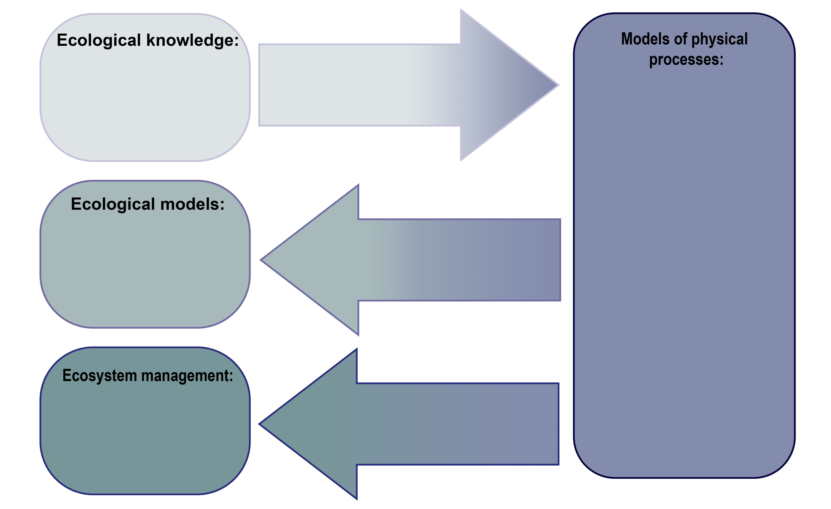
CEM Framework for H&H
2. Interchange between Disciplines
1. From Theoretical to Application (Ecology)
3. Analysis of Physical Space (Engineering)

Slide 5
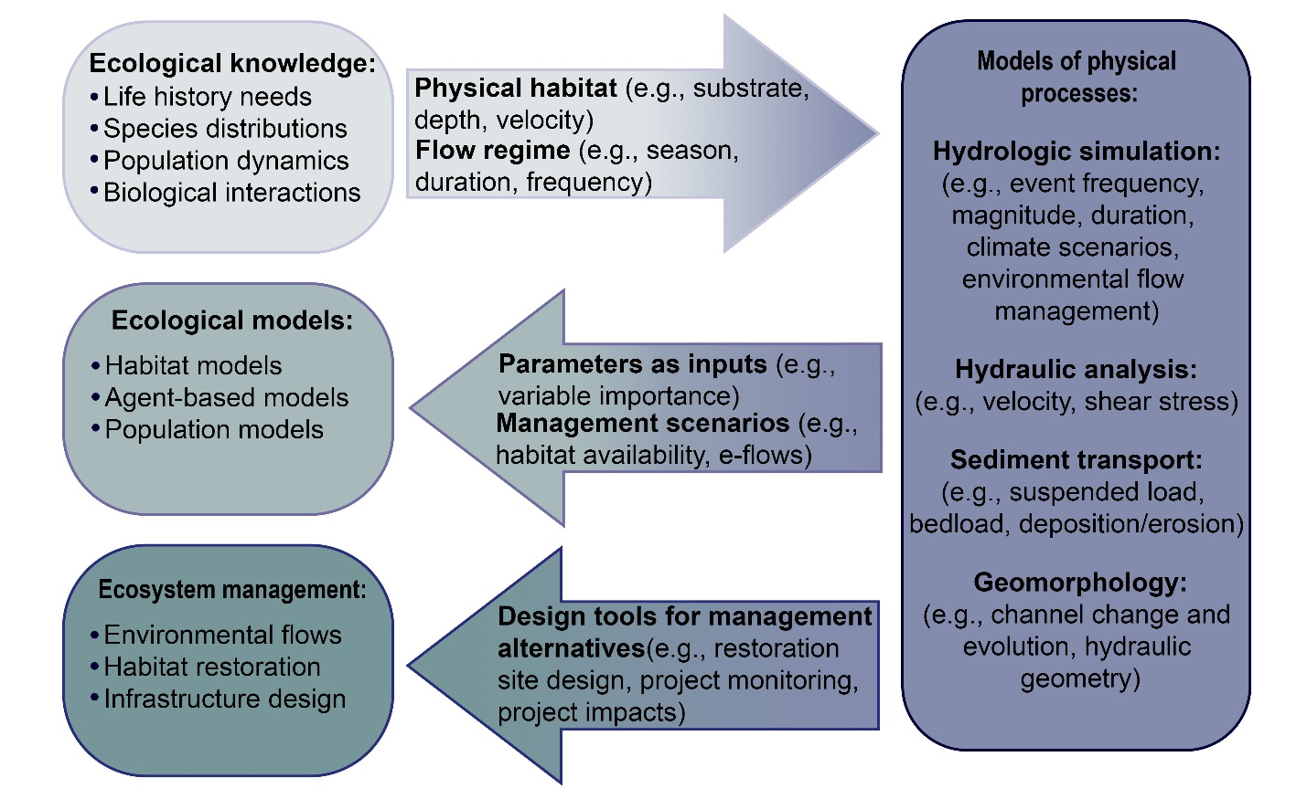
CEM Framework for H&H

Slide 6
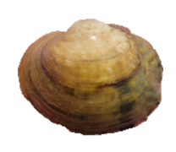
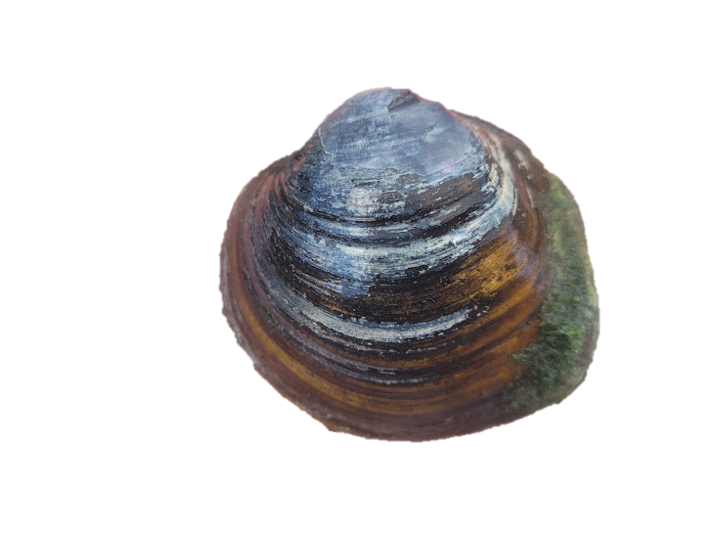
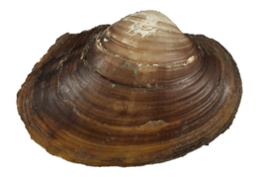
Case study #1: Freshwater mussels in the San Saba River, TX
Freshwater mussels:
Mostly sedentary benthic organisms
Patchily distributed in streams
Distribution is influenced in part by hydrodynamic variables
Haag et al. (2012); Lopez and Vaughn (2021)

Slide 7
Mussels in the San Saba River, TX
Cushway et al. (2024)

Slide 8
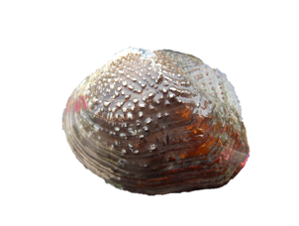
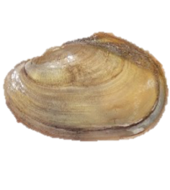
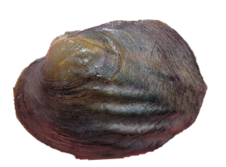
Literature review of mussel habitat preferences

Slide 9
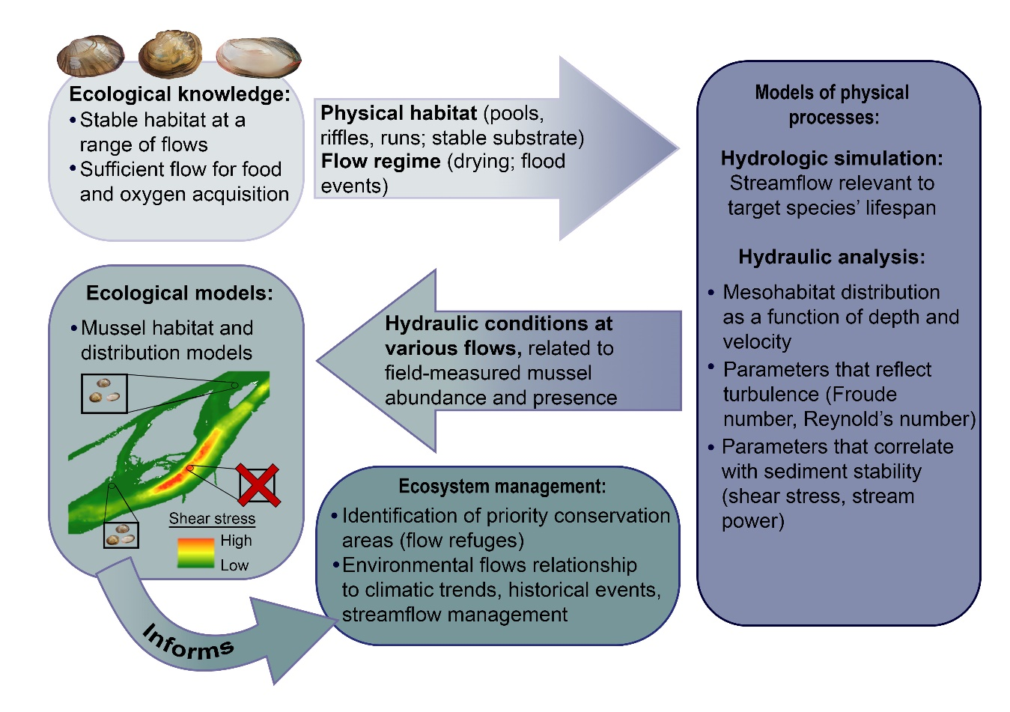
Conceptual ecological model for adult life stages
Harris and Cushway (in review)

Slide 10
Linking hydraulic models with ecological analysis
Cushway et al. (2024)

Slide 11
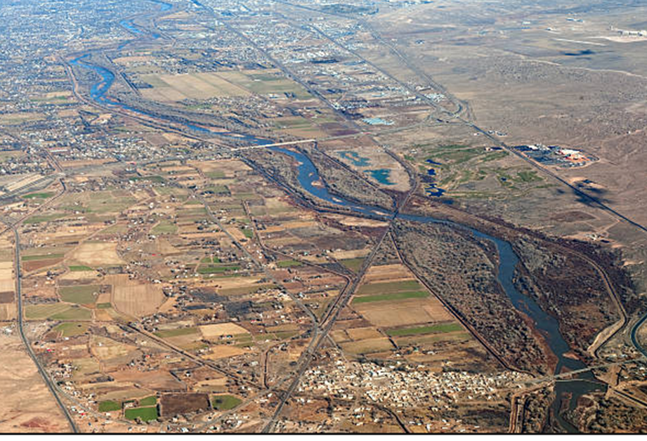
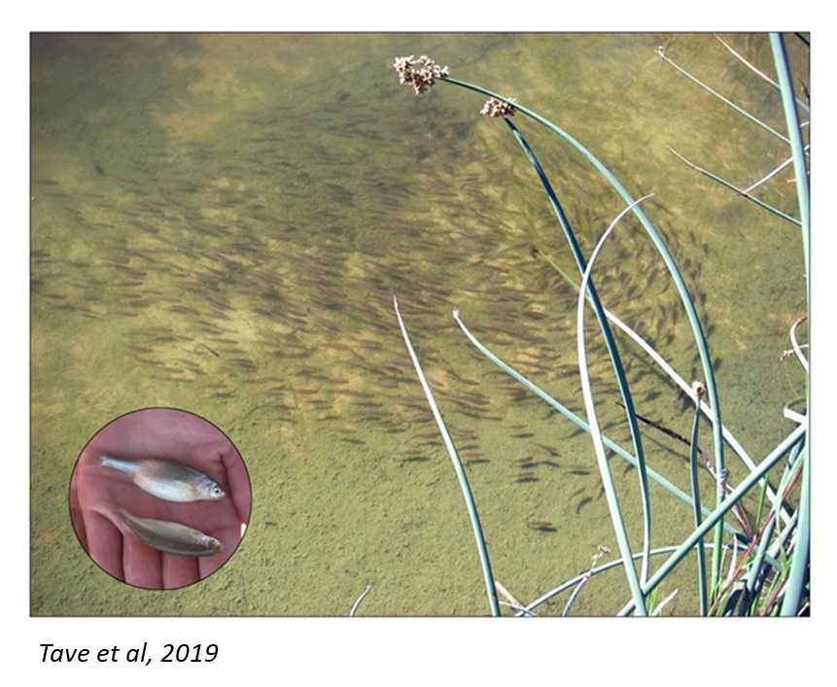
Case Study #2: E-flows for Rio Grande silvery minnow
Heavily engineered Rio Grande: disconnected from flood plain, leveed, dammed affects inundation.
Silvery minnow requires shallow, slow-moving refuge for maturation.

Slide 12
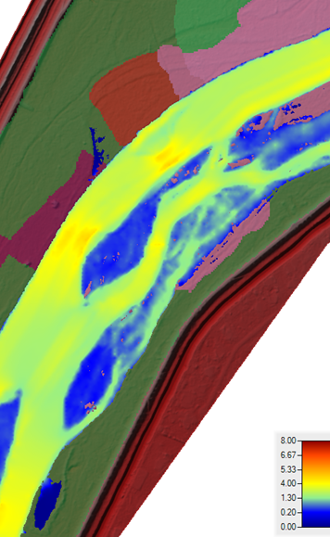
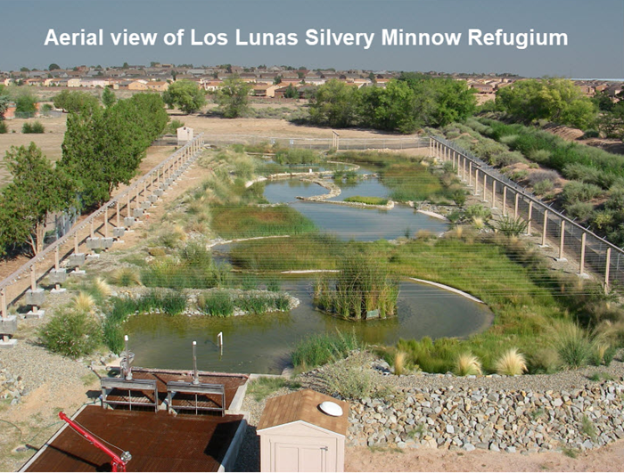
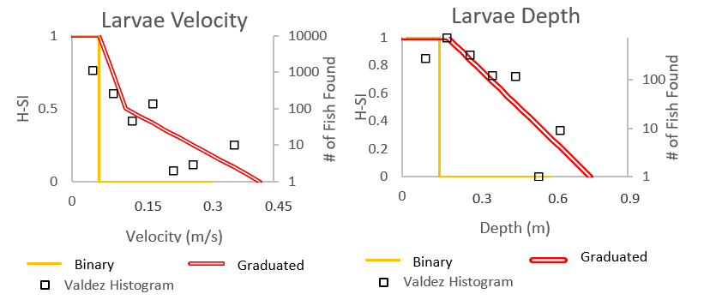
Linking River Engineering and Ecological Studies
Highly studied and monitored system:
Bathymetry, topography gathered for river maintenance studies.
Species studied in hatchery
Field data collection of physical habitat, species.

Slide 13
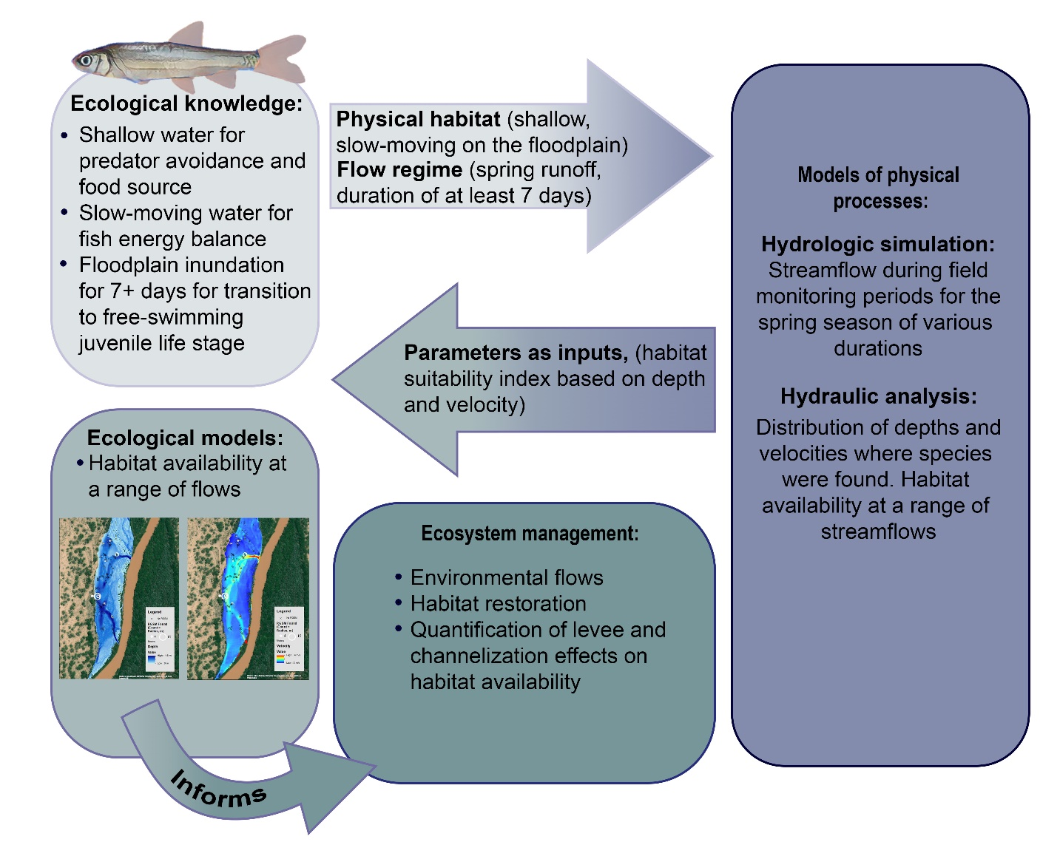

Slide 14
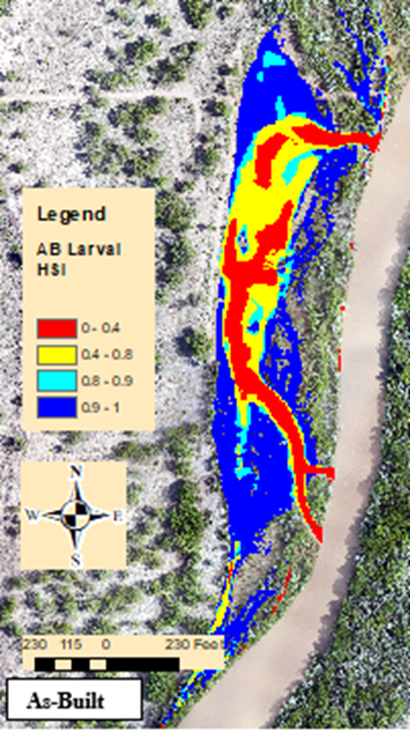
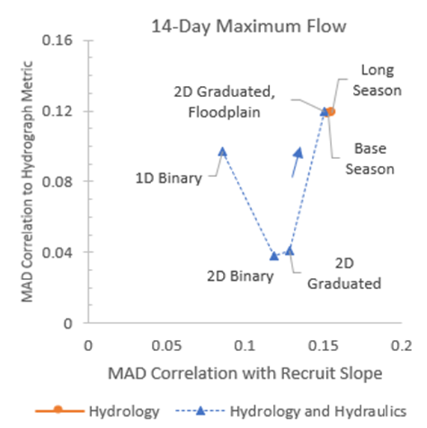
Result: Engineering Tools for Restoration
PLAN
Develop conceptual model.
CHECK
Did we follow the Plan?
ACT
Intervene the existing Plan to better align with lessons learned in previous steps.
DO
Define the problem, the solution, monitoring or performance metrics
Enact the plan.
Quantitative model, design, monitor.
Does the Plan realize truths defined in the conceptual model?
Validates H-SI
Allows for site performance and alternatives analysis formulation using HEC-RAS.
Allows habitat quality to be quantified at project-scale and reach-scale.
Can assess effects of water management decisions for coordination.
Monitoring;
Adaptive Management.

Slide 15
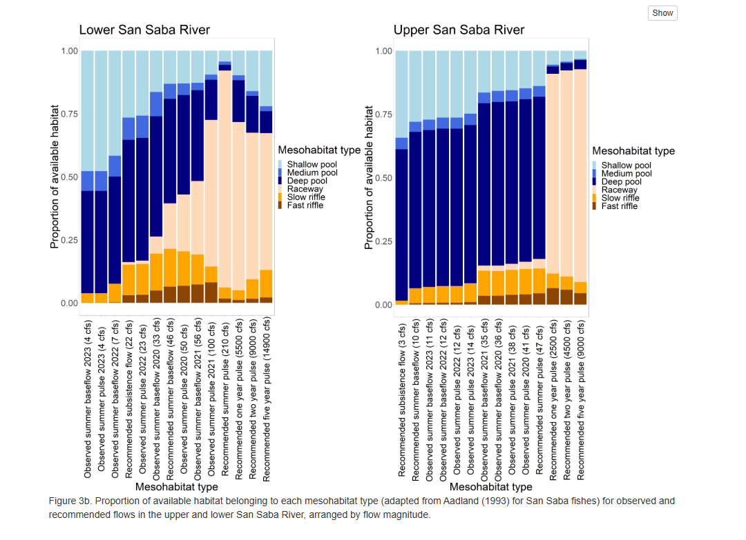
Other/Future Work
Machine Learning for hundreds of e-flow + physical habitat variables and mussel distribution.
Physical habitat for San Saba fishes under water mgmt. decisions. (+Perkin)
Native/Non-native recruitment patterns under same flows/different geomorphologies. (+McKay and WRISES)

Slide 16
Summary
Upcoming Tech Note: “Developing Conceptual Ecological Models for Hydraulic Analysis”
Presents a framework, discussion tool for collaboration in engineering and ecological disciplines.
Demoed with two case studies (the TN presents a third: riparian invasive/native vegetation).

Slide 17
References
Harris and Cushway (TBP). Developing Conceptual Ecological Models for Hydraulic Analysis. ERDC/ANSRP Tech Note.
Mussel Case Study:
Cushway et al 2024. Go with the flow: Impacts of high and low flow conditions on freshwater mussel assemblages and distribution. PLOS One.
Rio Grande Silvery Minnow Case Study:
Harris et al 2023. Hydraulic analysis for assessing environmental flow selection and ecological model formulation. Ecohydrology.
Harris et al 2024. Developing a habitat suitability index with field data and hydraulic models. River Research and Applications.

