Slide 1
Predicting Riverine Temperature to Inform Ecological Analysis
Samantha Wiest, Darixa Hernandez-Abrams, S. Kyle McKay
ANSRP Webinar
Presenter: Samantha Wiest
U.S. Army Engineer Research and Development Center (ERDC)
Environmental Laboratory (EL) samantha.r.wiest@erdc.dren.mil
July 16, 2025

Slide 2





Author Bios
Report Authors:
Samantha Wiest – Research Ecological Engineer
Interests: ecosystem restoration, ecological modeling, stormwater management, hydraulic modeling
Darixa Hernandez-Abrams MSc, PhD student – Research Ecologist
Interests: ecosystem restoration, ecological modeling, evaluating environmental effects of USACE projects
Dr. Kyle McKay, MSc, PhD – Research Civil Engineer
Interests: effects of water source mgmt., ecosystem restoration, modeling

Slide 3
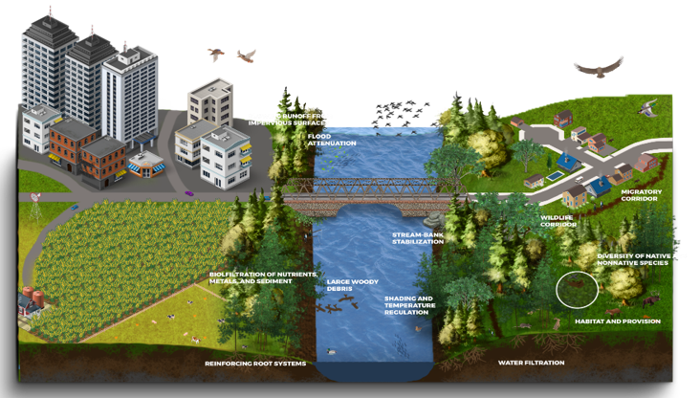
Project Context – Coupling Riparian and Stream Processes to Improve Prediction of Freshwater Mussels
(PI: Darixa Hernandez Abrams)
Problem Statement
Riparian zones provide vital habitat for mussel and fish hosts by controlling erosion, filtering water, moderating hydrology, providing nutrients, and offering shade (Atkinson et al., 2012).
The relationship between riparian ecosystems and mussel populations remains underexplored.
Further R&D is essential to guide riparian habitat management strategies that support freshwater mussel communities.
Conceptual model of riparian zone functions
(Wiest et al. in review)

Slide 4
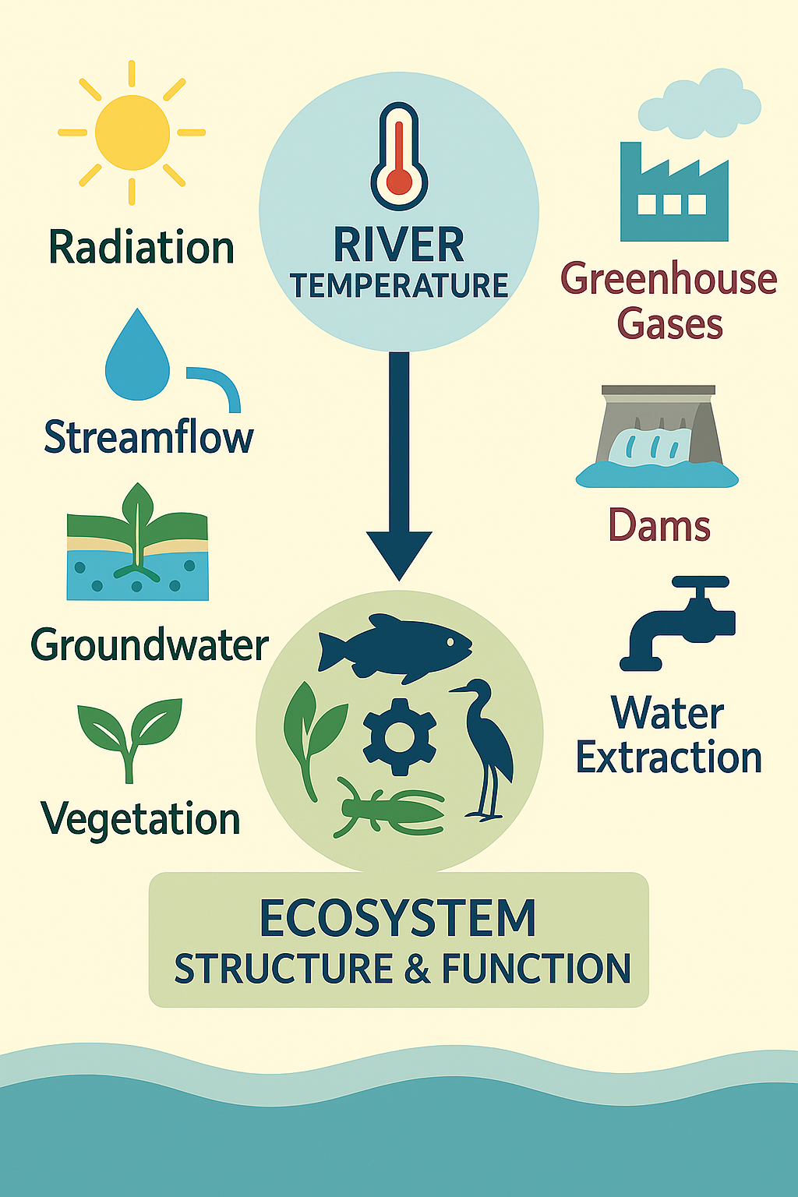
Introduction: Why River Temperature Matters
High influence on structure and function of freshwater ecosystems
Driven by complex interactions (air temp, streamflow, groundwater, radiation, vegetation, climate…)
Growing influence of anthropogenic stressors (land use changes, water extraction, greenhouse gases impoundments…)
However, receives less attention than hydrology/hydraulic studies

Slide 5
Tech Note Purpose
Discuss thermal regime drivers and ecological effects
Provide guidance on existing thermal modeling tools when applied within ecological frameworks
Demonstrate the application of thermal modeling through a case study on the Upper San Saba River

Slide 6
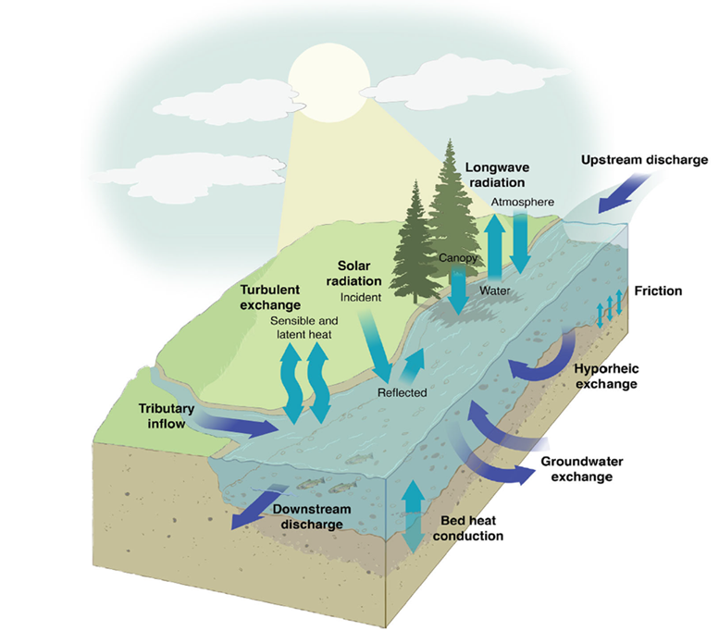
Thermal Regime Drivers
Three major physical processes
Advection and dispersion mechanisms – inflow and outflow processes (e.g., upstream temp delivery, tributaries or groundwater inputs
Stream-atmospheric interactions – solar and long wave radiation (e.g., topographic shading, reflectance or absorption, riparian shading)
Conduction of ground temperatures –
hyporheic exchange and bed friction
regulating temperatures
Conceptual model of riverine thermal regimes
(Leach et al. 2023)

Slide 7
Ecological Effects
Individual
Behavior
Population and community
Production
Growth
Development
Reproduction
Ecosystem
Species distribution
Habitat suitability
Reproduction (spawning and migratory cues)
Food web dynamics
Respiration
Nutrient cycling rates
Eutrophication

Slide 8
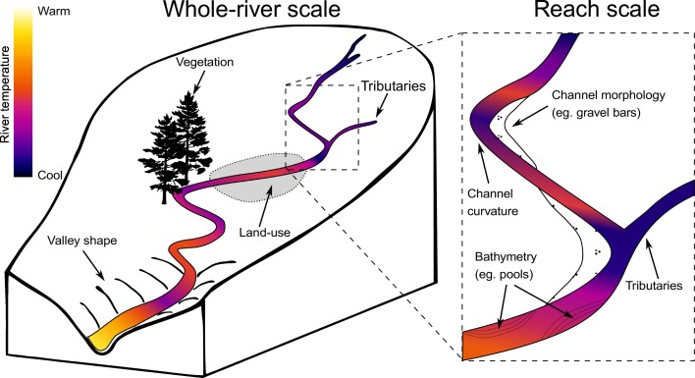
Thermal Modeling in Ecology
Key driver of freshwater ecosystem processes and species physiology
Historically less studied than other water quality variables like sediment or nutrients
Renewed interest due to climate change and human impacts (e.g. dams, land use)
Advances in technology now enable better monitoring and modeling across scales
Basin controls on river water temperature heterogeneity across multiple scales (Dugdale et al. 2017)
Notes:
Types of thermal models​
Regression Models​
Simple statistical relationships​
Quick estimates​
Stochastic Models​
Time-series analysis​
Efficient for daily/seasonal variability ​
Deterministic (Process-Based) Models​
Simulate physical energy processes​
Ideal for scenario analysis and mechanistic understanding

Slide 9
Thermal Modeling in Ecology
Model Type | Examples | Intended Application | Data Inputs | Outputs
Deterministic / Process-Based | HEC-RAS, CE-QUAL-W2, ClearWater-Riverine | Scenario modeling; habitat suitability; process understanding | Air temp, solar radiation, riparian shade, streamflow, meteorological data | Temp profiles (1D/2D); energy fluxes
Stochastic | Time-series, ARIMA | Predicting daily/seasonal trends with minimal input | Air temp; historical water temp | Daily/seasonal temp predictions
Regression / Statistical | Linear regression, ANN, k-NN | Screening analysis; broad-scale habitat assessments | Air temp, riparian cover, discharge | Site-specific temp estimates
Model Type | Advantages | Limitations
Deterministic / Process-Based | Mechanistic insight Scenario evaluation High spatial/temporal resolution | Data-intensive Requires calibration Complex implementation
Stochastic | Efficient with minimal data Good for long-term time series analysis | Lacks process detail Not suitable for novel scenarios
Regression / Statistical | Fast to implement Low data requirement Works well at large scale | Weak transferability No mechanistic interpretation
Comparisons of thermal model types for riverine systems
(Wiest et al. forthcoming)

Slide 10
Thermal Modeling in Ecology
Choose stochastic model
Q1: Do you want to test scenarios or understand processes?
START
Yes
No
Yes
Choose process-based (deterministic) model
Q2: Do you have detailed data and modeling capacity?
Q3: Are you focused on predicting temperature trends with minimal data?
Q4: Do you need daily or seasonal time-series predictions?
Choose regression model
Yes
Yes
No
No
No
Consider simpler or hybrid approach
Q5: Is your focus broad-scale, needing quick estimates?
Choose regression model
Yes
No
Process-Based Model may still be useful
Notes:
Types of thermal models​
Regression Models​
Simple statistical relationships​
Quick estimates​
Stochastic Models​
Time-series analysis​
Efficient for daily/seasonal variability ​
Deterministic (Process-Based) Models​
Simulate physical energy processes​
Ideal for scenario analysis and mechanistic understanding

Slide 11
Scoping Thermal Analysis
Questions to guide model/tool selection
What is the context for the analysis?
What are major drivers of thermal regimes in this basin?
What are the focal ecological outcomes?
What elements of the thermal regime are most critical?
How is temperature varying spatially in this watershed?
What level of effort?
What thermal modeling tools and approaches meet these needs?

Slide 12
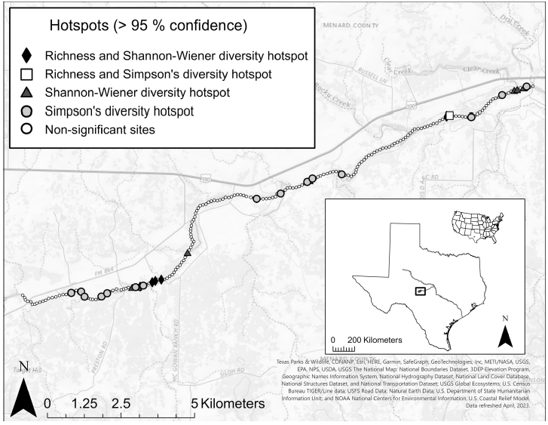
San Saba River, TX Case Study – work in progress
To demonstrate the application of thermal modeling within an ecological context
Located in central Texas
  Supports multiple freshwater mussel species
Existing 1D hydraulic HEC-RAS model expanded to simulate stream temperature
Integrated meteorological inputs:
  Atmospheric pressure
  Air temperature
  Solar radiation
  Wind speed, humidity, cloud cover
Calibration using field data collected in 2018 and 2019
Mussel species hotspots within the San Saba River, TX. (Cushway et al. 2024)

Slide 13
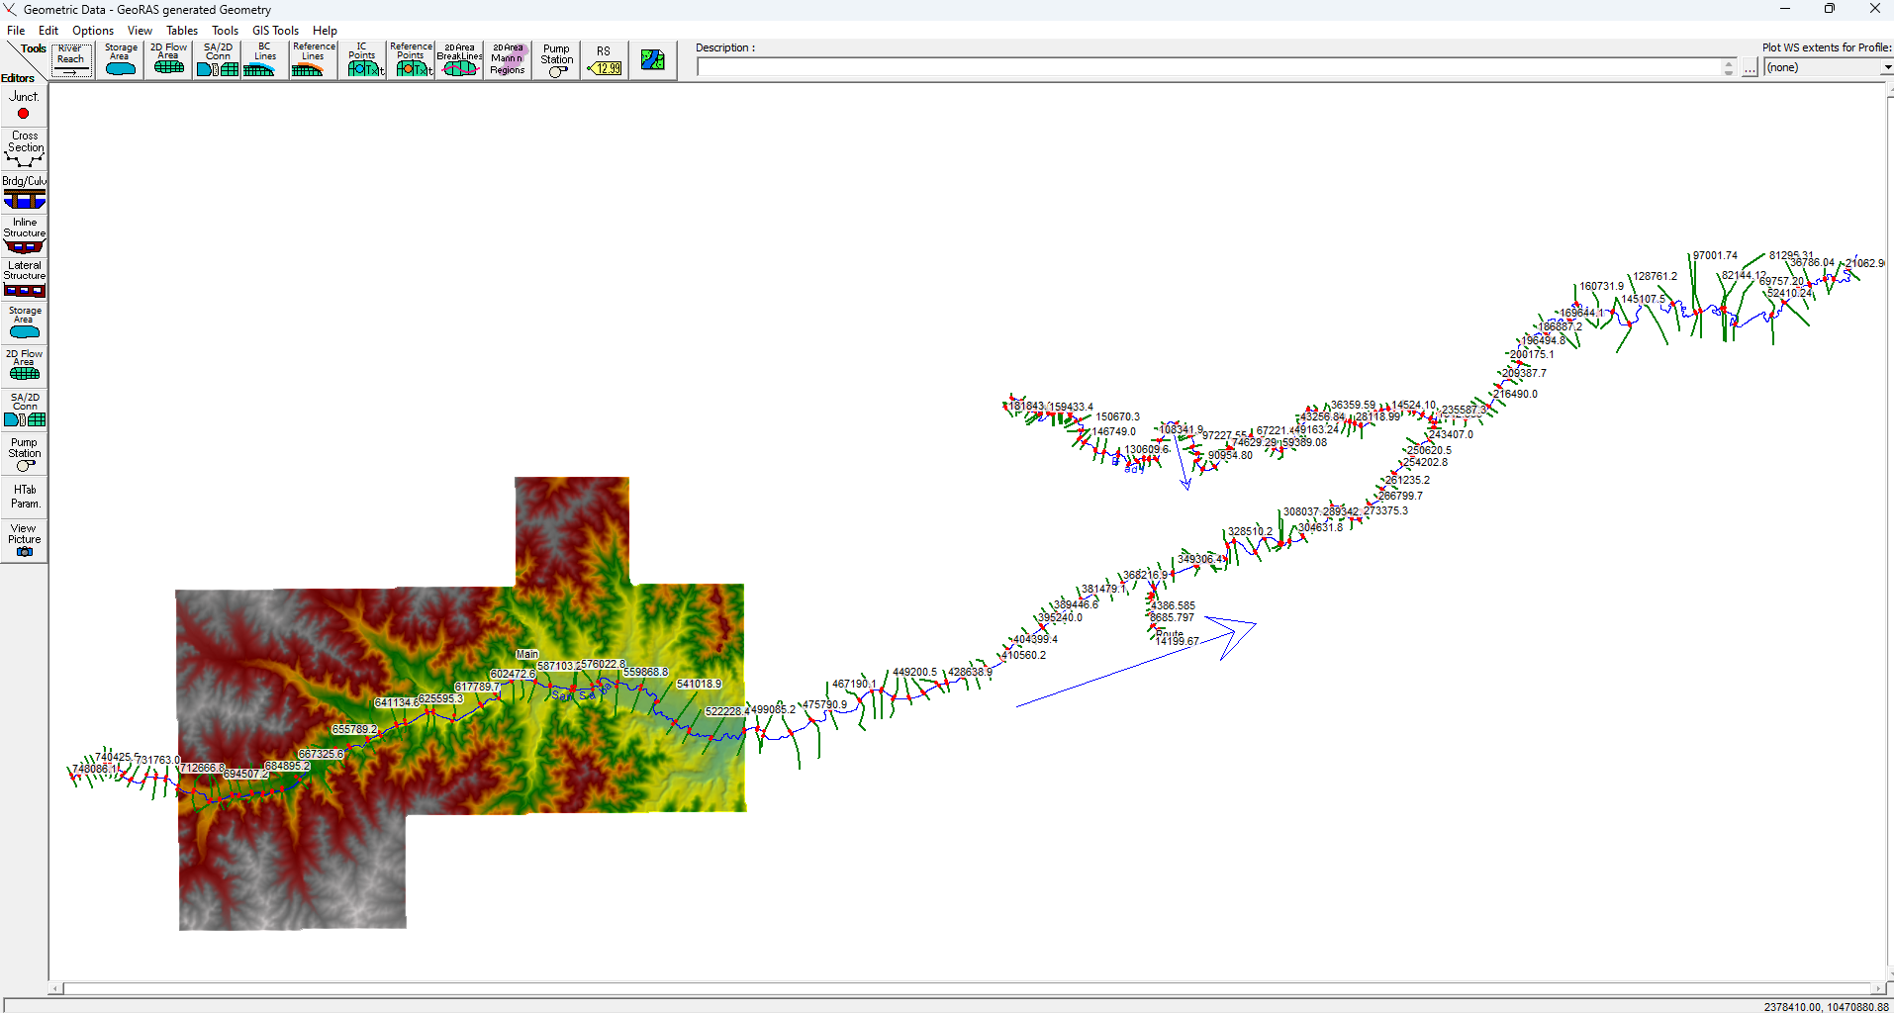
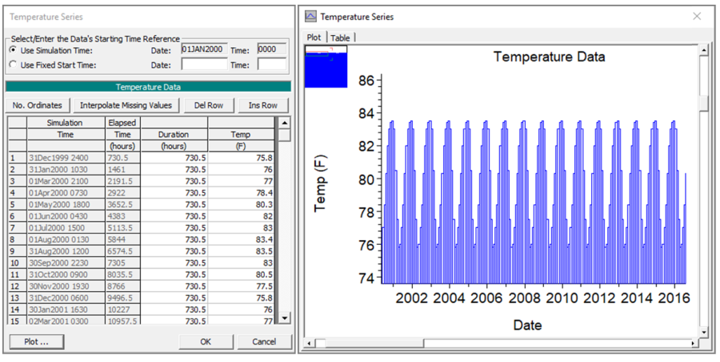
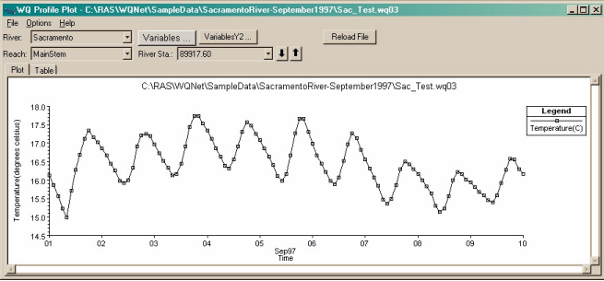
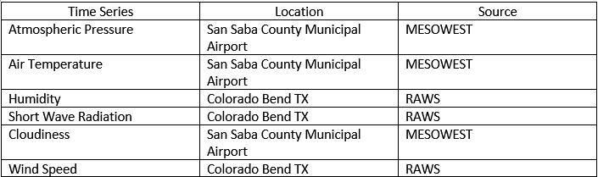
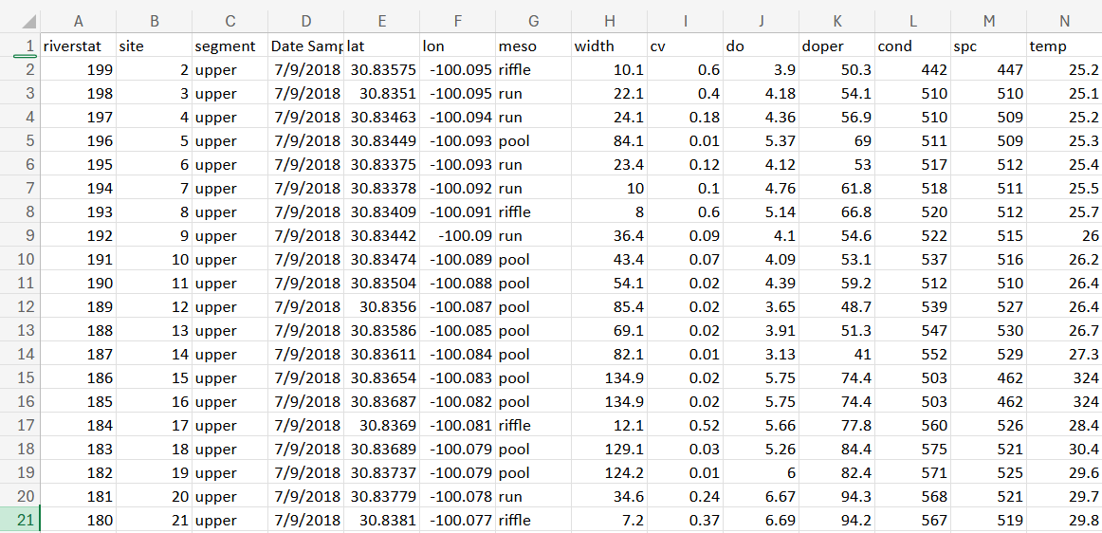
San Saba River, TX Case Study/1D HEC-RAS Thermal Model – work flow
1. Set up base model
Utilize existing Upper San Saba 1D geometry data (Harris et al. 2023)
2. Define model parameters
- Input meteorological data
- Add boundary conditions
- Set time series
3. Run Model
4. Calibrate Model
Using TXState 2018 field temperature data
5. Analyze Results
Use profile plots, time series plots, and cross-sectional plots to analyze stream temperature

Slide 14
Key Takeaways
River temperature is a vital but underused variable in ecological assessments
Model choice depends on:
  Ecological question/objective
  Data availability
  Desired level of detail
Case study demonstrates how hydraulic models can be extended to include temperature analysis
Thermal modeling supports habitat management for sensitive species like freshwater mussels
Integrating temperature models with ecological analysis improves decision-making for river management

Slide 15
Thank you!
Aquatic Nuisance Species Research Program – funding
Todd swannack – EL
Brook Herman – EL
Todd Steissberg – EL
Aubrey harris – EL
Kiara Cushway – EL
Mark Jensen – IWR

